Slide 1
Data Science for Health Care

Slide 2
Contents
What is Data Analytics?
Why Data Analytics?
How Data Analytics?
Types of Data Analytics
Data Analytics Framework
Who is who?
Tools used in Data Analytics
Uses of Data Analytics in Healthcare
Popular algorithms in Data Analytics

Slide 3
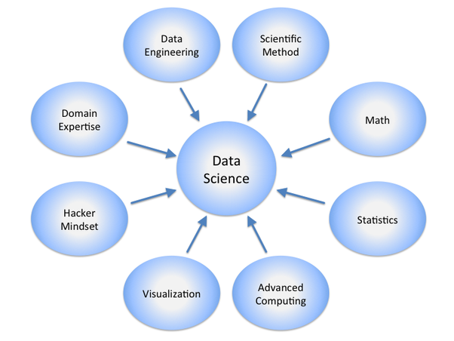
What is Data analytics (DA) ?
DA is:
Science of examining raw data
Purpose is to draw conclusions about the information.
Used in
many industries to allow companies and organizations to make better business decisions
sciences to verify or disprove existing models or theories.

Slide 4
What is Data analytics (DA) ? - continued
DA helps to answer some key questions:
Who are our best customers?
When is there a Dengue fever epidemic in Chennai?
When a customer is likely to jump ship & go to a competitor?
What is the best criteria that predicts success when hiring a new Ph.D. student to become a faculty member?
What is the number one reason for the success of Cricket batsman?

Slide 5
Why Data analytics (DA) ?
To improve financial performance, strategic management, and operational efficiency of organizations because it unlocks the predictive potential of data analysis
Offers new opportunities for a competitive advantage since BA is the intersection of business and technology

Slide 6
Why Data analytics (DA) ? - continued
Big Bazaar finding out what sells in a hurricane
Netflix finding out what movies a customer might want to watch
Amazon personalizing and customizing websites
Airtel finding out that a customer might want to drop its service before the customer even knows it

Slide 7
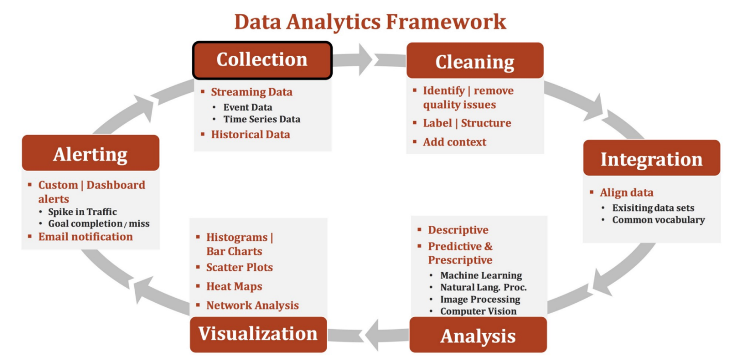
How ?
Streaming data is the transfer of data at a steady high-speed rate sufficient to support such applications as high-definition television (HDTV)
Event data are the instantaneous values recorded at each sampling interval.
As a scientific discipline, computer vision is concerned with the theory and technology for building artificial systems that obtain information from images or multi-dimensional data.
Heat map (or heatmap) is a graphical representation of data where the individual values contained in a matrix are represented as colors.

Slide 8
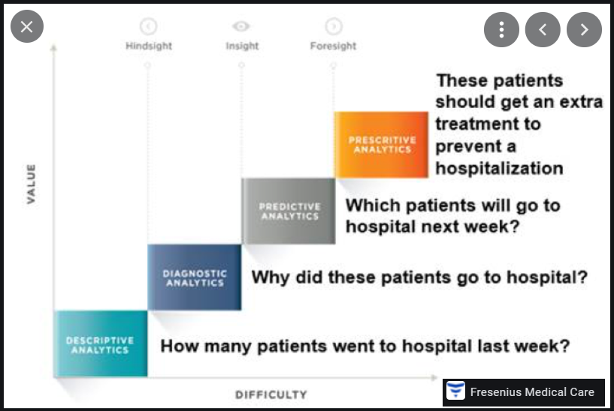
Types of Data Analytics

Slide 9
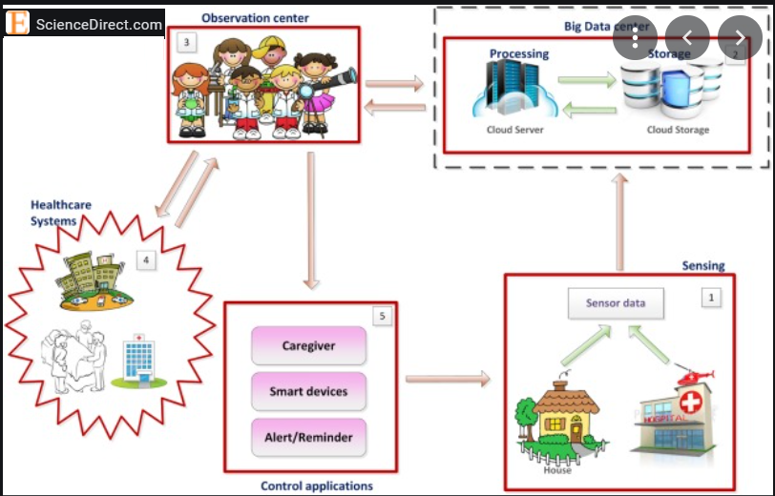
Data Analytics Framework for Healthcare Services

Slide 10
Who is who ?
A Data Scientist | A Data Engineer
Identifies relevant data sets needed for data analytics applications | Builds data pipelines to pull together data from different systems
Works with others to collect, integrate and prepare data for analysis | Aids data scientists in integrating, consolidating and cleansing data
Develops, trains and runs analytical models and assesses their findings | Structures and organizes data for use in specific analytics applications
Communicates the results to business owners and other end users | Develops and implements scripts for database maintenance, monitoring, and performance tuning to be applied across the business

Slide 11




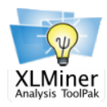













Tools used in Data Analytics

Slide 12
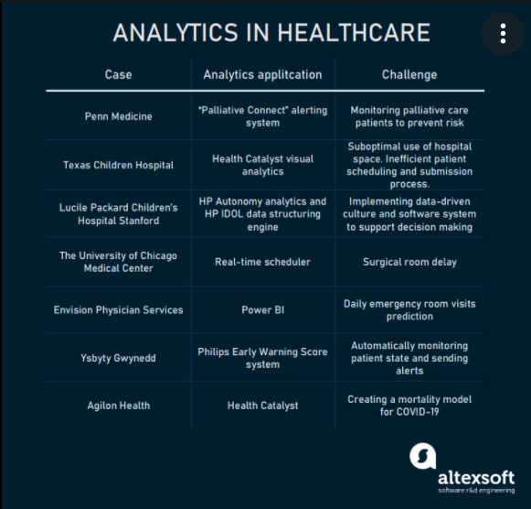
Uses of Data Analytics in Healthcare

Slide 13
Uses of Data Analytics
Internet Search: All search engines make use of data science algorithms to deliver the best result. Google processes more than 20 petabytes of data every day.
2. Digital Advertisements: Starting from the display banners on various websites to the digital bill boards at the airports - almost all of them are decided by using data science algorithms.
3. Recommender Systems: Using the previous search results for a user, Internet giants such as Amazon, Google Play, Twitter etc. make recommendations for their products.

Slide 14
Uses of Data Analytics - continued
Image Recognition: Facebook give suggestions to tag your friends when you upload your image with friends by using Image recognition
Fraud and Risk Detection: Banks and Financial Institutions push their products and also evaluate the risks of probabilities of loan default based on customer demographics, credit profile, customer preferences
Delivery Logistics: Using data science companies such as DHL, FedEx, UPS have discovered the best route to ship goods at the best suited time to deliver

Slide 15
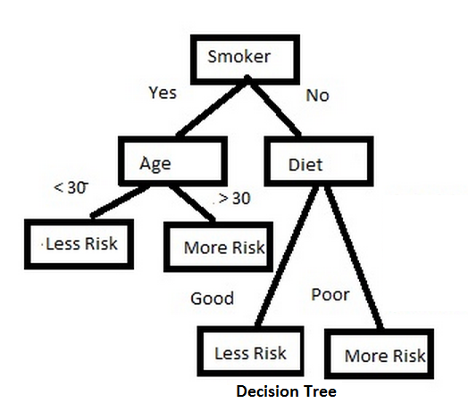
Popular algorithms in Data Analytics
Classification Algorithm
Classification algorithms enable you to model categorical response variable as a function of one or more predictors.
Decision Tree learning is the construction of a decision tree from class-labeled training tuples.
A decision tree is a flow-chart like structure, where each internal (non-leaf) node denotes a test on an attribute, each branch represents the outcome of a test, and each leaf (or terminal) node holds a class label. The topmost node in a tree is the root node.

Slide 16
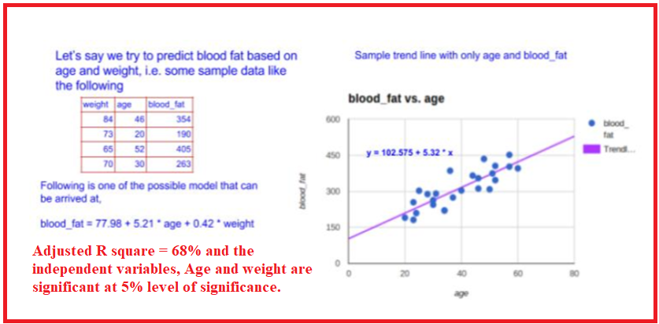
Popular algorithms in Data Analytics
Regression Algorithm
Regression is a technique used to predict a range of numeric values (also called continuous values), given a particular dataset.

Slide 17
Introduction to Regression
Linear regression is a mathematical technique for finding the straight line that best fits the values of a linear function, plotted on a scatter graph as data points. - Business Dictionary*
Response variable (aka dependent or outcome or target) is the variable of focus in a research study.
Predictor variable (aka independent or explanatory) is the variable that explains the variation in the response variable and it might affect the response variable.
For example, the response variable is volume of Sales in thousands on a given day in an online stores and the predictor variable is the advertisement expenses.
Focus of the regression analysis is on the relationship between a response variable and one or more predictor variables. To be more specific, this helps one to understand how the typical value of the response variable changes when any one of the predictor variables varies, keeping other predictor variables constant.
Reference:
http://www.businessdictionary.com/definition/linear-regression.html
https://en.wikipedia.org/wiki/Regression_analysis
3

Slide 18
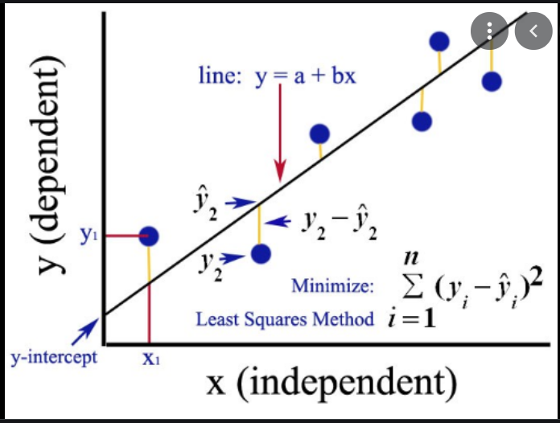
Introduction to Regression - continued
Ordinary Least Squares

Slide 19
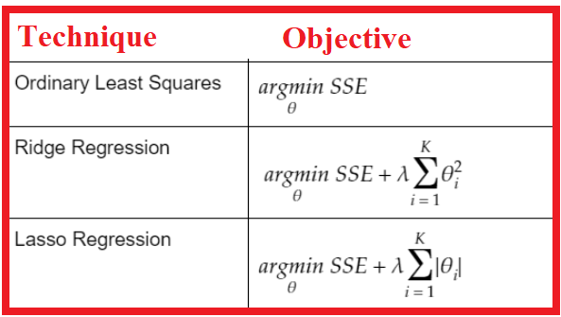
Introduction to Regression - continued

Slide 20
Introduction to Regression - continued
Application of regression
Primary uses for regression in business:
1) Forecasting - to predict events that have yet to occur. For example, number of health policy holders who will claim insurance amount
2) Optimization of business process. For example it is important for any service organization to know the relationship between the number of calls made to the customer care by customers and number of customers churned

Slide 21
Introduction to Regression - continued
Identification of problem
Before doing the regression analysis, one must review the literature to develop a deep understanding of the relevant variables, their relationships, and the expected coefficient signs and effect magnitude.
Refer http://statisticsbyjim.com/regression/regression-analysis-tips/
To determine the response variable, Pedhazur* suggests that the variable have acceptable measurement qualities (i.e., reliability and validity).
Goal of the model selection is to minimize the number of predictors which account for the maximum variance in the response variable.
Refer https://www.ncbi.nlm.nih.gov/pmc/articles/PMC2845248/#B15
* Pedhazur EJ. Multiple Regression in Behavioral Research. 3rd. ed. Fort Worth, TX: Harcourt Brace College Publishers; 1997.

Slide 22
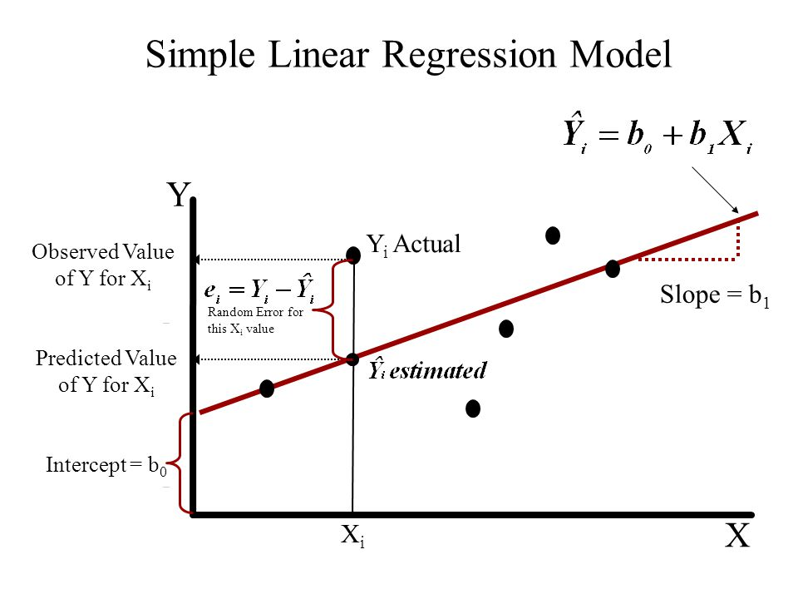
Introduction to Regression - continued
Prediction of response based on predictors
Simple Linear Regression (SLR)
It is a statistical model in which there is only one predictor variable and one response variable.
Let (X_{i}, Y_{i}) where i is ranging from 1 to n be a dataset of n observations.
Then the regression equation can be written as
Y_{i} = β₀ + β₁X_{i} + ε_{i}, where
Y_{i} is the i^{th} observation of the response variable in the sample
X_{i} is the i^{th} observation of the predictor variable in the sample
ε_{i} is the random error or residuals
β₀, β₁ are the regression parameters or regression coefficients

Slide 23
Introduction to Regression - continued
Note:
The relationship is not a mathematical model relationship and hence the error term.
The linearity condition is defined with respect to the regression coefficients and not with respect to the predictor variables. Thus Y_{i} = β₀ + β_{1log(}X_{i)} + ε_{i} is a linear model but relationship between Y and X is not linear.
Regression calculates the most likely outcome based on a trend of one or more known independent variables and the impact of changing one of the independent variables.

Slide 24
Introduction to Regression - continued
Regression within the umbrella of machine learning
Regression and classification are branded under the same umbrella of supervised machine learning.
Both utilize known datasets to make predictions.
In supervised learning, an algorithm is employed to learn the mapping function from X (input) to Y (output), Y = f(X).
The objective is to approximate the mapping function, f as accurately as possible so that we can predict output variable, Y for a new input X as close as possible to the actual value.
The response variable in the regression is continuous numerical variable and for classification it is categorical.
In machine learning, regression algorithms attempt to estimate the mapping function, f from the predictor variables (X) to continuous numerical response variable, Y
Supervised learning is used to predict a certain target variable from a model you trained with known data.
Regression is a kind of supervised learning where you predict numerical variable in interval scale.

Slide 25
Introduction to Regression - continued
1. Continuous Response, Single Predictor
Simple Linear Regression (SLR) is a statistical method that allows us to summarize and study relationships between two continuous numerical variables, wherein
a) one variable being the predictor variable, x and
b) the other being the response variable, y.
We call this as simple linear regression because it concerns the study of only one predictor variable.
From correlation to regression
Regression and correlation analysis techniques are employed to study the relationships between variables.
Regression is used to predict the value of one variable based on the value of a different variable.
Correlation is a measure of the strength of a relationship between variables.

Slide 26
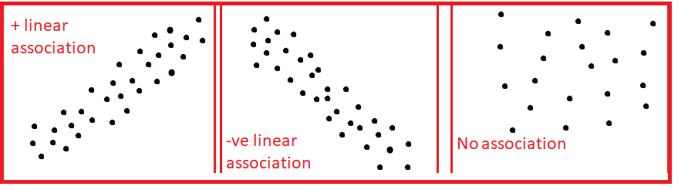
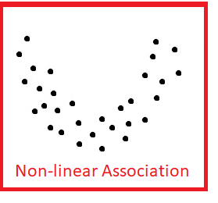
Introduction to Regression - continued
Limitation of correlation
Correlation does not mean causation.
Correlation can suggest there is a relationship between two variables but it cannot prove that one variable causes a change in another variable. For example, the correlation might suggest that there is a relationship between sales quantity of a new product and price of the new product. But it cannot suggest how the price of the new product will cause changes in sales quantity.
Scatterplot: visualization of dependency
A scatter plot is a plot of two variables that will reveal the relationship (linear or non-linear) between two variables.
It is useful for assessing the strength of the relationship and to find if there are any outliers in the data.

Slide 27
Introduction to Regression - continued
Scatterplots for various correlation values
Correlation Coefficient: 1
Correlation Coefficient: -1
Correlation Coefficient: 0.011

Slide 28
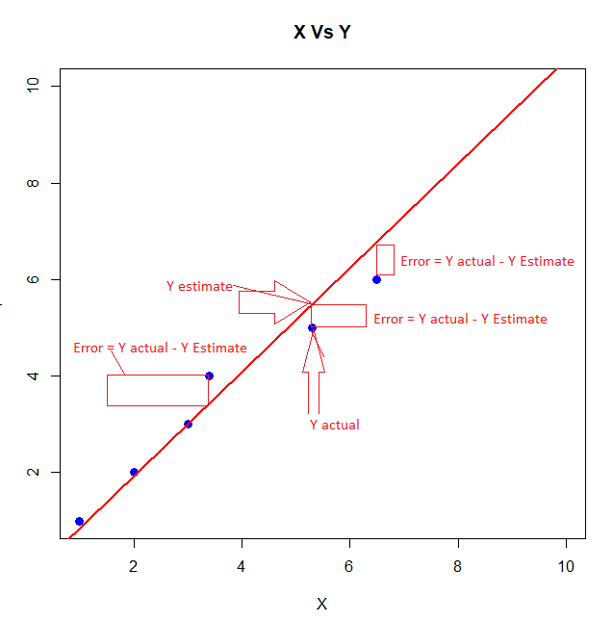
Introduction to Regression - continued
Fitting a regression line: Model, Error
Linear regression consists of finding the best fitting straight line through the points.
Regression line is the red diagonal line in the figure and consists of the predicted score on Y for each possible value of X.
The error of prediction for a point is the value of the actual observation minus the estimated value which is on the line.
Regression line: Y' = β₀ + β₁X, where Y' is the predicted Y, β₁ is the slope and β₀ is the Y intercept and Y – Y’ is the error in prediction

Slide 29
Introduction to Regression - continued
Fitting a regression line: Model, Error - example
Obtain a regression equation between hours studied and marks scored data given below:
Scatter plot reveals a very strong positive relationship.
Let us proceed with analysis using Regression in Excel Data Analysis.

Slide 30
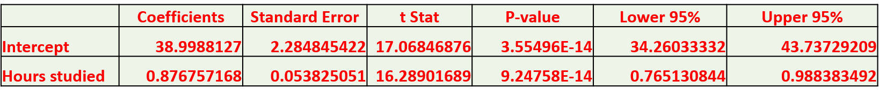
Introduction to Regression - continued
Fitting a regression line: Model, Error - example
We get the following coefficients table:
From the coefficients table, we observe that the p value for the coefficient for the variable, Hours Studied to be very small, 9.25e-14.
At 5% level of significance, we conclude that the coefficient for Hours Studied is statistically significant as the p value is less than 0.05 and reject the null hypothesis (H0: Coefficient of the parameter is 0).
95% Confidence interval describes the uncertainty inherent in the estimate and describes a range of values containing the true value, on each occasion, if a study were repeated infinite times. If the interval is wider, the uncertainty is greater indicating our poor knowledge about the effect of the independent variable on the dependent variable.
We also observe that the 95% confidence interval for the Hours Studied is 0.76513 to 0.98838 is not very wide and does not include 0.

Slide 31
Introduction to Regression - continued
Fitting a regression line: Model, Error - example
We get the following coefficients table:
Coefficients column provides the values for regression coefficients for the regression equation.
Marks = 38.9988127 + 0.876757168 * Hours Studied.
Here, the intercept is 38.9988 and slope is 0.8768
https://www.dummies.com/education/math/statistics/how-to-calculate-a-regression-line/

Slide 32
Introduction to Regression - continued
Value of intercept and slope: Interpretation
We get the following coefficients table:
Let the Regression line be y = ax + b
The y intercept is the point where the regression line crosses the y axis (where x = 0) and is denoted by b.
Here the slope is a.
These coefficient estimates (and b) reveal the relationship between the intendent variable, Hours Studied and the dependent variable, Marks. These estimates tell us the amount of increase in Marks for one hour increase in Hours Studied.
Interpret slope for the regression equation: Marks = 38.9988127 + 0.876757168 * Hours Studied.
So, for every unit (i.e.., one hour) increase in Hours Studied (holding other variables constant), an increase of 0.88 marks is predicted.

Slide 33
Introduction to Regression - continued
Value of intercept and slope: Interpretation - continued
Intercept is described as the mean response when all independent variables are set to zero.
There is always uncertainty in interpreting intercepts unlike slope which is always interpretable.
This does not make sense in many situations. This intercept can be regarded as a garbage collector for the regression model for any bias that is not accounted for by the terms in the model.
Regression intercept is not worth interpreting, in general.
http://blog.minitab.com/blog/adventures-in-statistics-2/regression-analysis-how-to-interpret-the-constant-y-intercept

Slide 34
Introduction to Regression - continued
Value of multiple R-square
R squared (or Multiple R² for multiple linear regression) is a goodness of fit measure for linear regression models. This statistic indicates the percentage of variance in the response or dependent variable that the model explain (or independent variables explain collectively).
R squared is also called the coefficient of determination. It reveals how many data points fall within the results of the regression line.
R squared is the percentage of the response variable variation that a linear model explains.
R² = Variance explained by the model / Total variance
It lies between 0 and 100 and 0% represents the model does not explain any of the variation in the dependent variable around its mean while 100% explains all of the variation in the dependent variable around its mean.
R squared cannot determine whether the coefficient estimates are biased. So we use residual plots to check bias.
A high R² is necessary for precise predictions in addition to the requirement that the residuals are randomly scattered around 0.

Slide 35
Introduction to Regression - continued
Correlation coefficient & R-square
R-squared is the square of the coefficient of correlation.
For example, correlation coefficient between marks and hours studied is 0.96095.
From the regression statistics table, we observe that
R Square is 0.9234 which is same as the square of the correlation coefficient (0.96095) which is 0.9234.

Slide 36
Introduction to Regression - continued
10) Sign of correlation coefficient and regression slope
When we examine our Least square regression lines and corresponding values of correlation coefficient, r,
we observe sign of the correlation coefficient and slope of the regression line is same.
For example, in the marks example, we observe the sign of the correlation coefficient is positive (0.96095) and the slope of the regression line (0.8768) is also positive.
Formula for Slope
α = r(Sy / Sx) where Sx if the standard deviation of x and Sy is the standard deviation of y and r is the correlation coefficient between x and y.
Since Sy and Sx are positive, both slope, a and r, the correlation coefficient have the same sign.

Slide 37
Introduction to Regression - continued
11) Fitted values, predicted value of response for a new X
Regression equation is used to predict the unknown value of the response variable, y when the values of the predictor variables, X are known.
For example, you want to predict the marks of a student, who has spent 15 hours for studying the subject.
We know, the regression equation is Marks = 38.9988127 + 0.876757168 * Hours Studied.
Marks = 38.9988127 + 0.876757168 X 15 = 52.15017 or 52 Marks

Slide 38
Introduction to Regression - continued
Scope of regression
In Linear regression, we examine the following:
a) Does the set of independent or predictor variables predict a dependent or target or response variable?
b) Which variables in particular are significant predictors of the target variable and how they impact the target variable?
We assume that the historically observed data forms the basis for future predictions and the response and predictor variables are associated or related.

Slide 39
Introduction to Regression - continued
Assumptions of Linear Regression
Absence of multi-collinearity
Errors between the observed and predicted values should be normally distributed. For regressions, the test of normality applies to model's residuals and not the variables themselves.
Homoscedasticity: We check heteroscedasticity using Goldfeld Quandt.
Linear and additive relationship exists between the response and predictor variables.

Slide 40
Introduction to Regression - continued
Summary
Primary goal of Regression is to establish the existence of an association relationship between a dependent variable and independent variables.
In Simple Linear Regression, the number of independent variable is one.
Correlation can suggest there is a relationship between two variables and cannot prove that one variable causes a change in other variables.
We have seen how to interpret the intercept and slope of a regression line.
R² is a percentage of the variation in the dependent variable explained by the model.
R² is the square of correlation coefficient.
Sign of the correlation coefficient and slope of the regression line is same.
Reference: Business Statistics – a first course – Davind M. Levine, Kathryn A. Szabat, David F Stephan and Dr P K Viswanathan Chapter 12

Slide 41
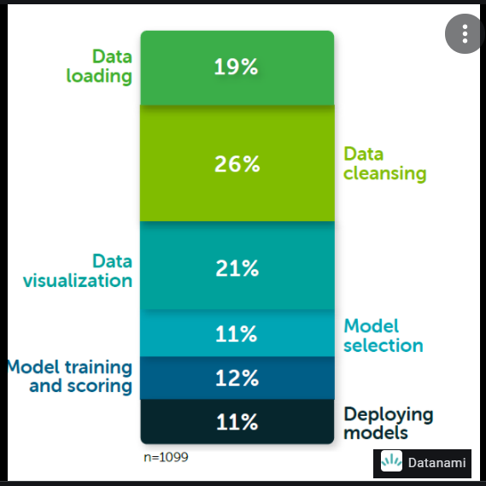

Slide 42

OPENREFINE - A DATA CLEANING TOOL

Slide 43
DATA CLEANING
Definition
Data cleansing or data cleaning is the process of detecting and correcting (or removing) corrupt or inaccurate records from a record set, table, or database and refers to identifying incomplete, incorrect, inaccurate or irrelevant parts of the data and then replacing, modifying, or deleting the dirty or coarse data.
It is the process of ensuring that your data is correct, consistent and useable by identifying any errors or corruptions in the data, correcting or deleting them, or manually processing them as needed to prevent the error from happening again.
Why data cleansing?
Data quality is of central importance to enterprises that rely on data for maintaining their operations.

Slide 44
DATA CLEANING
How to clean?
Develop and implement data constraints comprising the following:
Design data constraints
Data type constraints
Range constraints
Mandatory constraints
Unique constraints
List of values constraints
Regular expression patterns constraint
Cross validation of multiple fields constraints

Slide 45
DATA CLEANING
Design data constraints
1) Data type constraints such as Age field must be numeric, name field to be alphabetic etc. and willingness to subscribe to a new journal must be categorical with several levels
2) Range constraints such as the field date of leaving an organization must be later than date of joining; blood sugar level of a nondiabetic patient must be in the range 60 to 120 mg/dL or for others the range could be from 40 to 2500 mg/dL (Guinness World record)
3) Mandatory constraints such as blood pressure of a living patient cannot be zero or email address of the customer cannot be blank
4) Unique constraint implying a single field or combination of fields must be unique across the dataset. For example, an Indian citizen can have only one Aadhaar card number.

Slide 46
DATA CLEANING
Design data constraints - continued
5) List of values constraint such as the field gender can have one of three values Male, Female and Neutral; Postal code in India must appear in the Pin code directory released by India Post
6) Regular expression patterns constraint such an email address field must have the pattern local-part@domain as per RFC 3696 standard. For example info@abc.com is a valid email address and info#abc.com is not valid.
7) Cross validation of multiple fields.
For example, in laboratory medicine, the sum of the components of the differential white blood cell count must be equal to 100 (since they are all percentages).
In addition to the above, we need to fix structural errors like Country field can have entries like USA, US, United States of America, America all implying USA.

Slide 47
DATA CLEANING
Data cleansing tools
1) Openrefine
2) Trifacta Wrangler
3) Drake
4) TIBCO Clarity
5) Wincore
6) Data Cleaner
7) Data Ladder
8) Cloudingo
9) Reifier
10) IBM Infosphere Quality Stage

Slide 48
DATA CLEANING
Interactive Data Transformation Tools (IDT) vs Excel
You can use Microsoft Excel to sort your data based on numerical, alphabetical and custom-developed filters, which allows you to detect errors more easily.
Setting up these filters in a spreadsheet can be cumbersome, as they are a secondary functionality.
On a more general level, we could say that spreadsheets are designed to work on individual rows and cells
IDTs operate on large ranges of data at once.
These ‘spreadsheets on steroids’ offer an integrated and user-friendly interface through which end users can detect and correct errors.

Slide 49
DATA CLEANING
Openrefine tool
Openrefine, previously known as GoogleRefine, is a powerful, open source software which visualizes and manipulates large quantities of data all at once.
Openrefine looks like a spreadsheet, but operates like a database, allowing for increased discovery capabilities beyond programs like Microsoft Excel.
Openrefine is a Java program that runs on your machine (not in the cloud): it is a desktop application that uses your web browser as a graphical interface. No internet connection is needed, and none of the data or commands you enter in Openrefine are sent to a remote server.
Openrefine does not modify your original dataset. All actions are easily reversed in Openrefine and you can capture all the actions applied to your data and share this documentation with your publication as supplemental material.
Openrefine saves as you go. You can return to the project at any time to pick up where you left off or export your data to a new file.
Openrefine can be used to standardize and clean data across your file.

Slide 50
DATA CLEANING
Openrefine Basic functions
Openrefine can be used to explore, clean, and link data on a large scale.
Functions include:
Data Normalization
Column Reorganization
Faceting and Clustering
Tracking Operations
Exporting Data

Slide 51
DATA CLEANING
Reference
https://en.m.wikipedia.org/wiki/Data_cleansing
https://www.geotab.com/blog/data-cleaning/
https://sunscrapers.com/blog/why-is-clean-data-so-important-for-analytics-and-business-intelligence/
https://www.guinnessworldrecords.com/world-records/highest-blood-sugar-level/?fb_comment_id=811257658947726_974655159274641#:~:text=Michael%20Patrick%20Buonocore%20(USA)%20(,-120%20mg%2Fdl).
https://datacarpentry.org/OpenRefine-ecology-lesson/00-getting-started/
https://programminghistorian.org/en/lessons/cleaning-data-with-openrefine
https://en.m.wikipedia.org/wiki/OpenRefine
https://guides.library.illinois.edu/openrefine/about#:~:text=OpenRefine%2C%20previously%20known%20as%20GoogleRefine,beyond%20programs%20like%20Microsoft%20Excel.

Slide 52
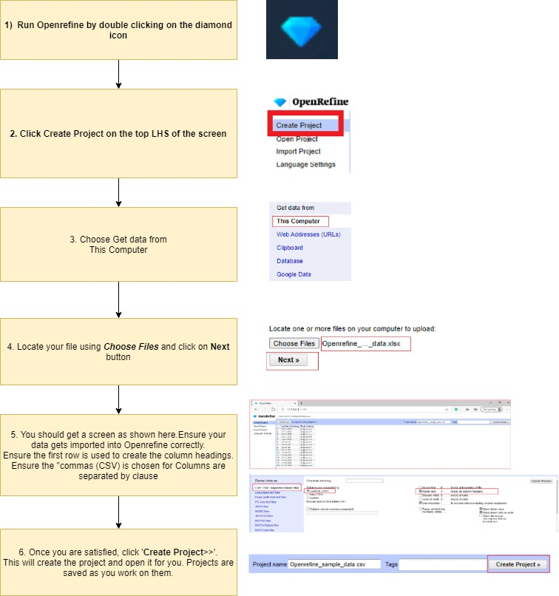
DATA CLEANING

Slide 53
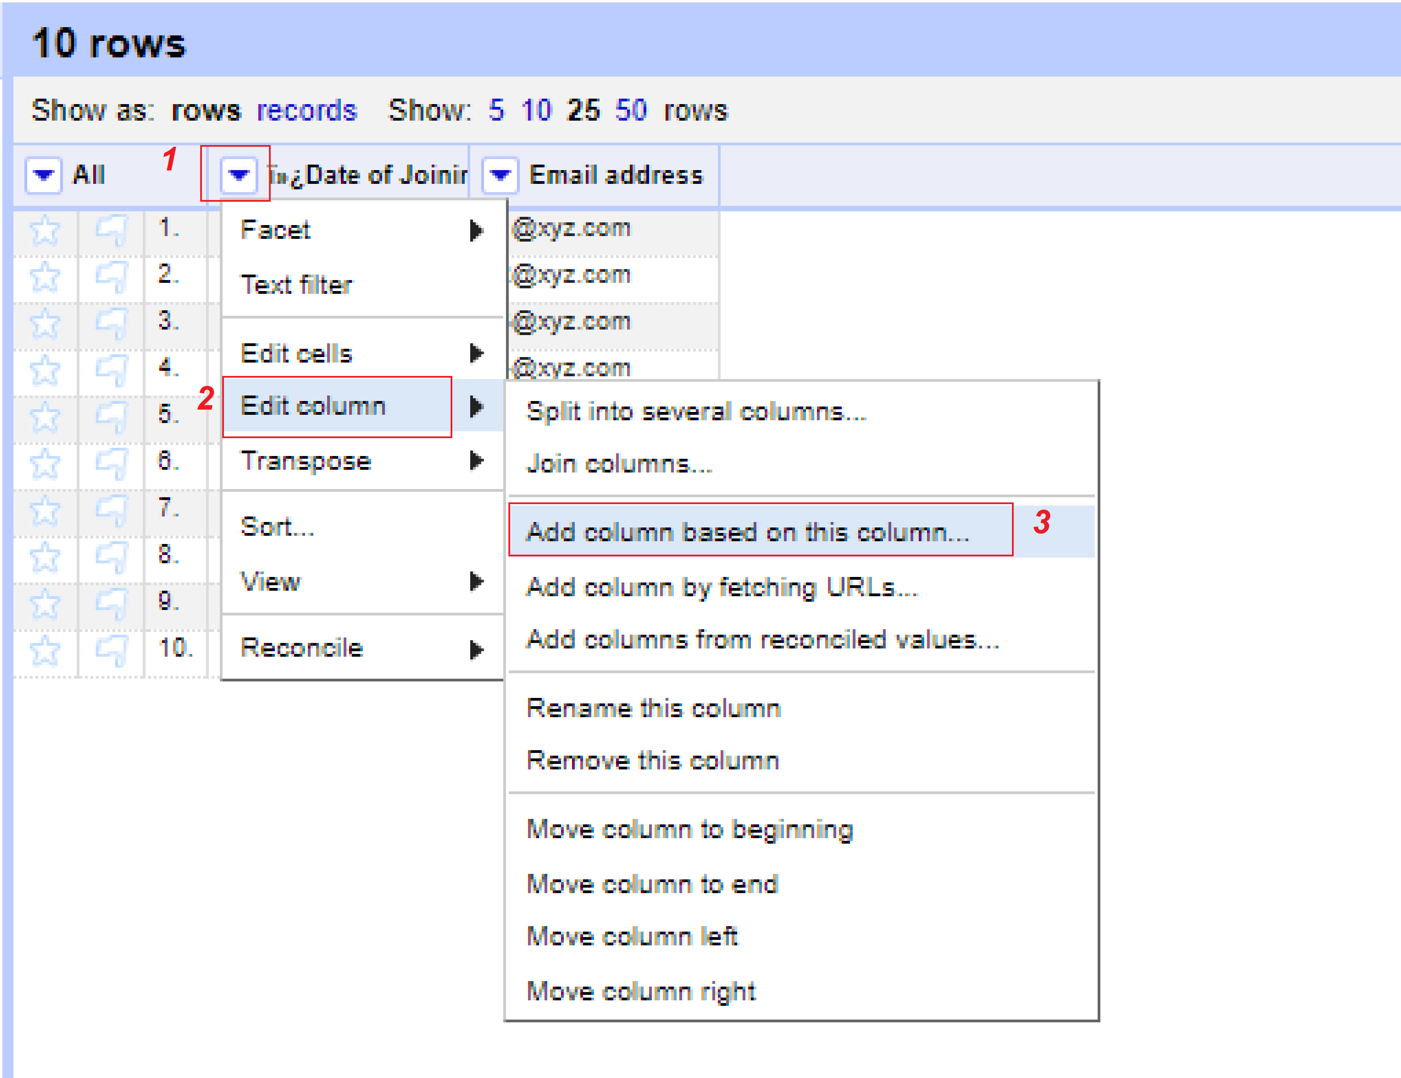
DATA CLEANING
Create a new column 'Edited_DOJ'
Create a new column 'Edited_DOJ' as follows:
1. Click on the LOV button near the column Date of Joining
2. Click on the Edit column tab
3. Click on the Add column based on this column

Slide 54
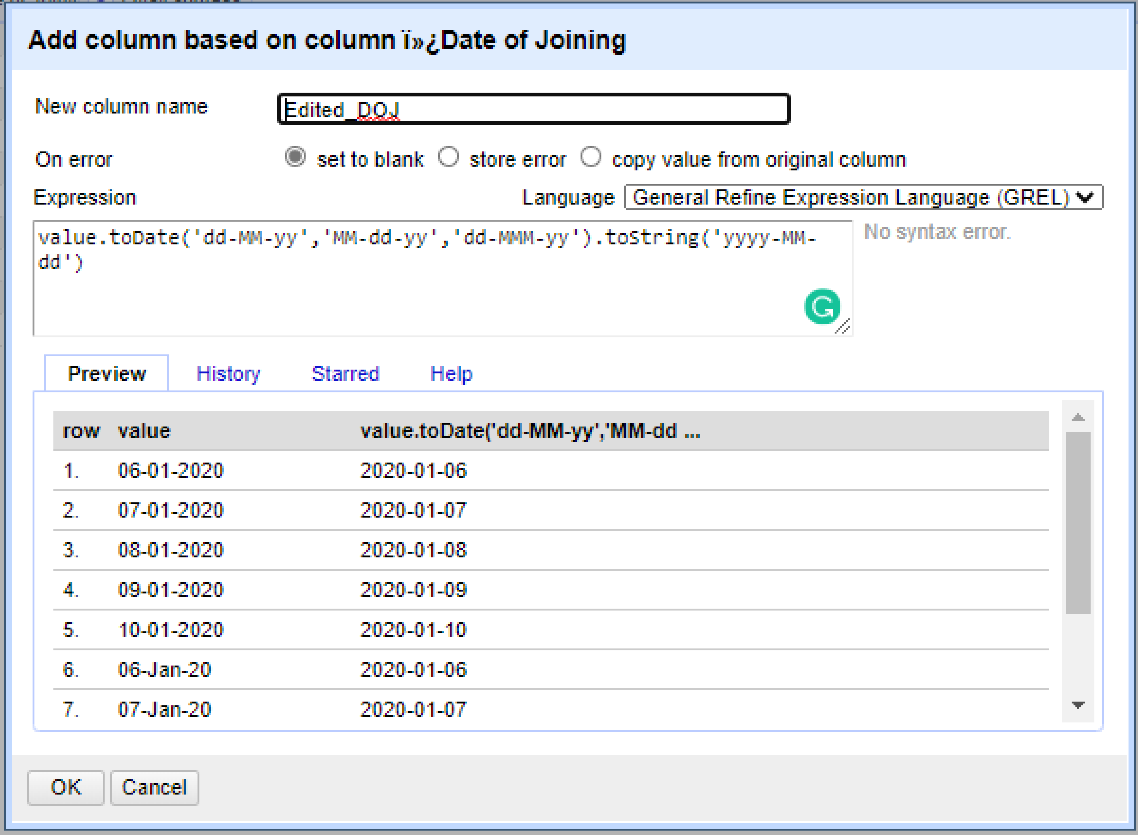
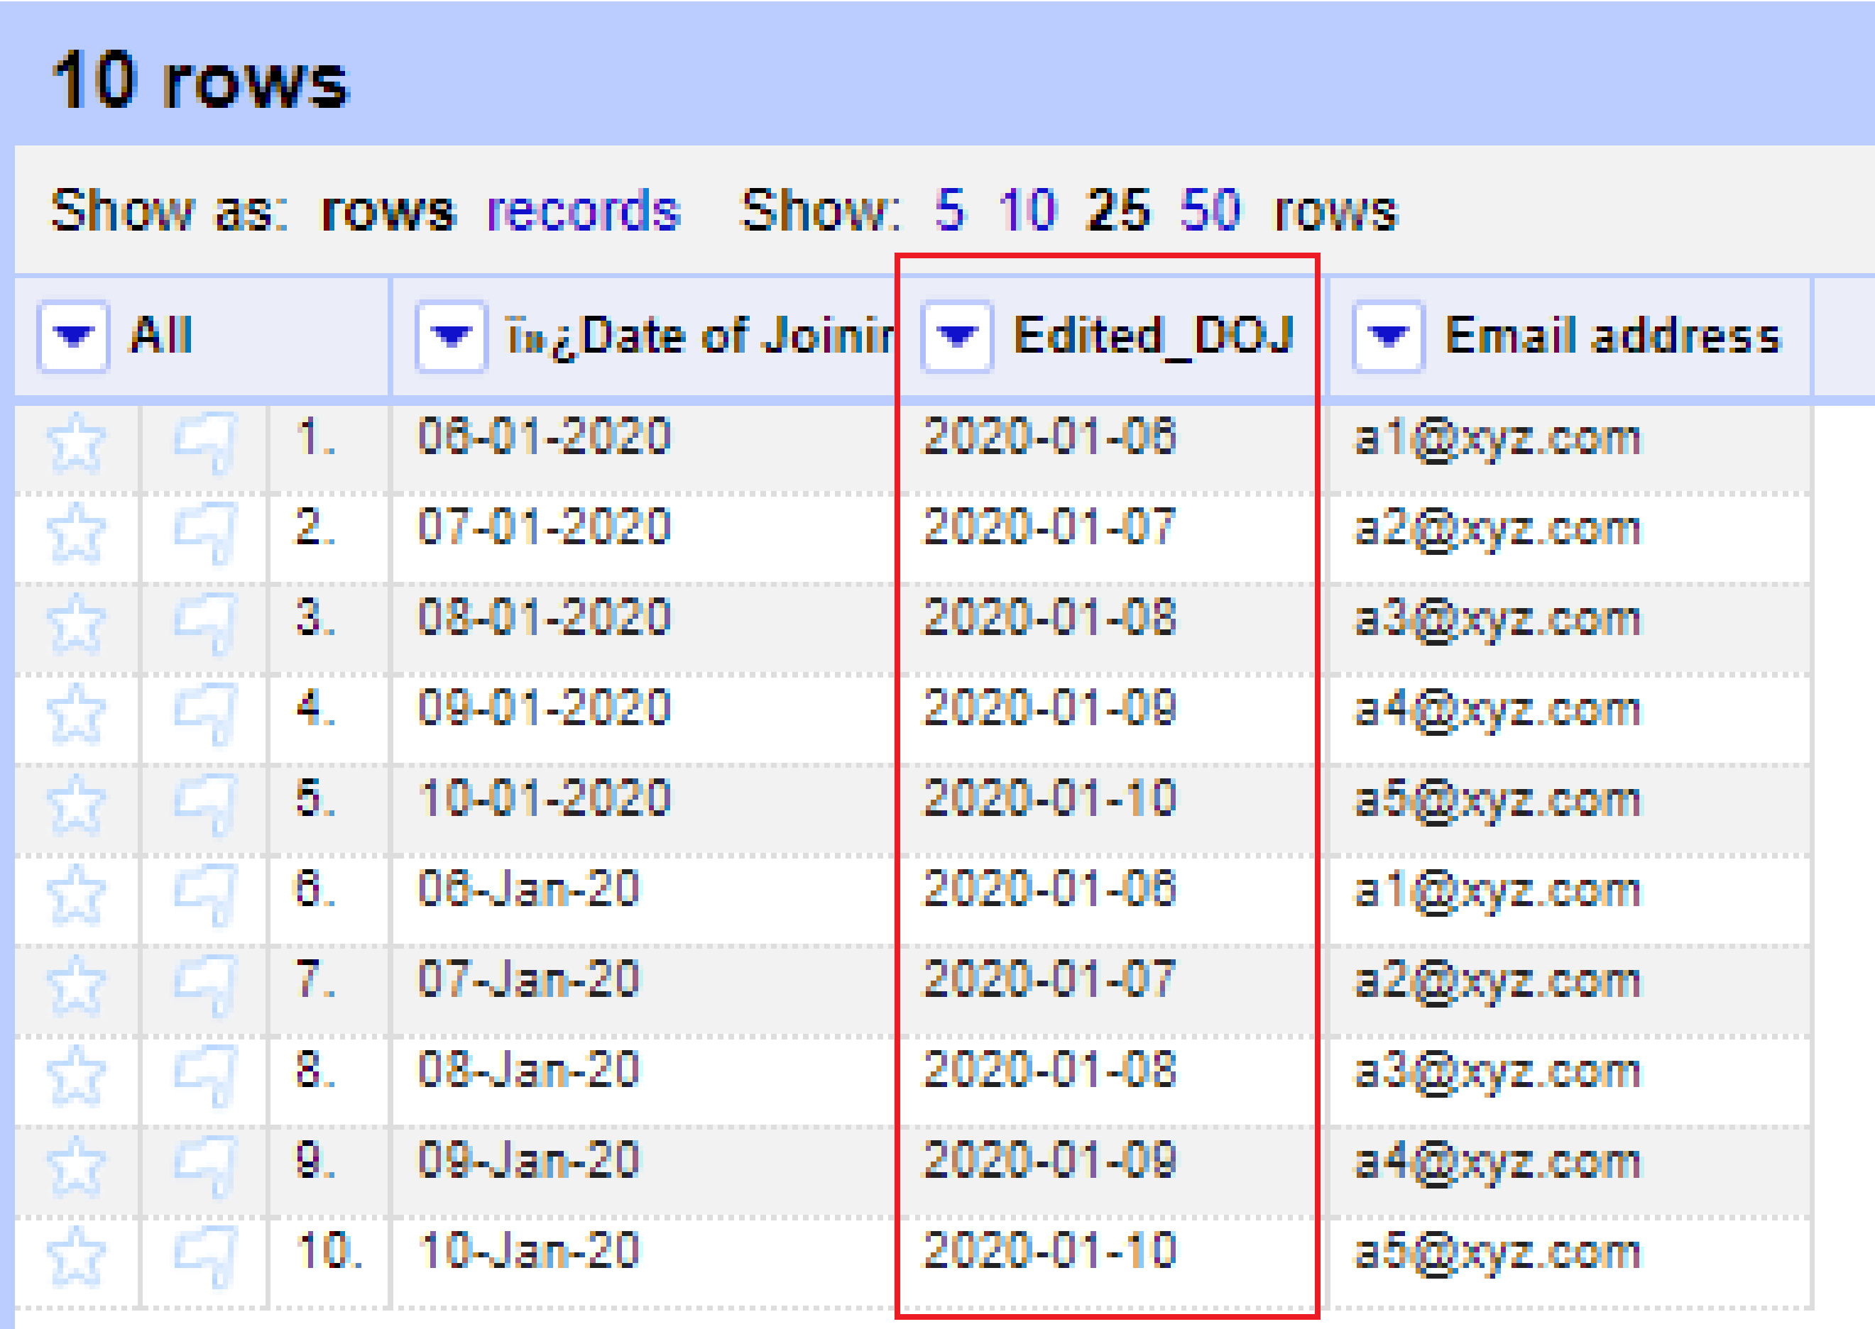
DATA CLEANING
Create a new column 'Edited_DOJ’ - continued
Create a new column 'Edited_DOJ' as follows:
1. Enter 'Edited_DOJ' for the New column name
2. Enter the following as the Expression and ensure the "Language is General Refine Expression Language"
value.toDate('dd-MM-yy','MM-dd-yy','dd-MMM-yy').toString('yyyy-MM-dd')
3. Click on the "OK" button.

Slide 55
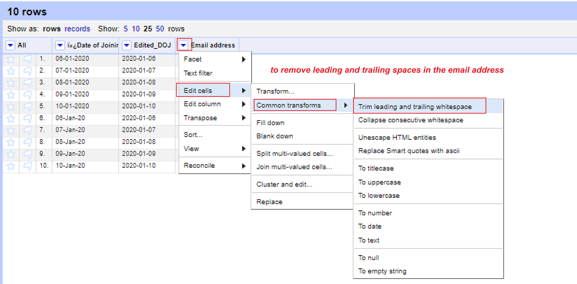
DATA CLEANING
How to remove leading and trailing spaces in the email address field?
1. Click on the LOV button near to the field, Email address.
2. Click on the menu item, Edit Cells >> Common transform >> Trim leading and trailing spaces.
3. You can see the new data

Slide 56
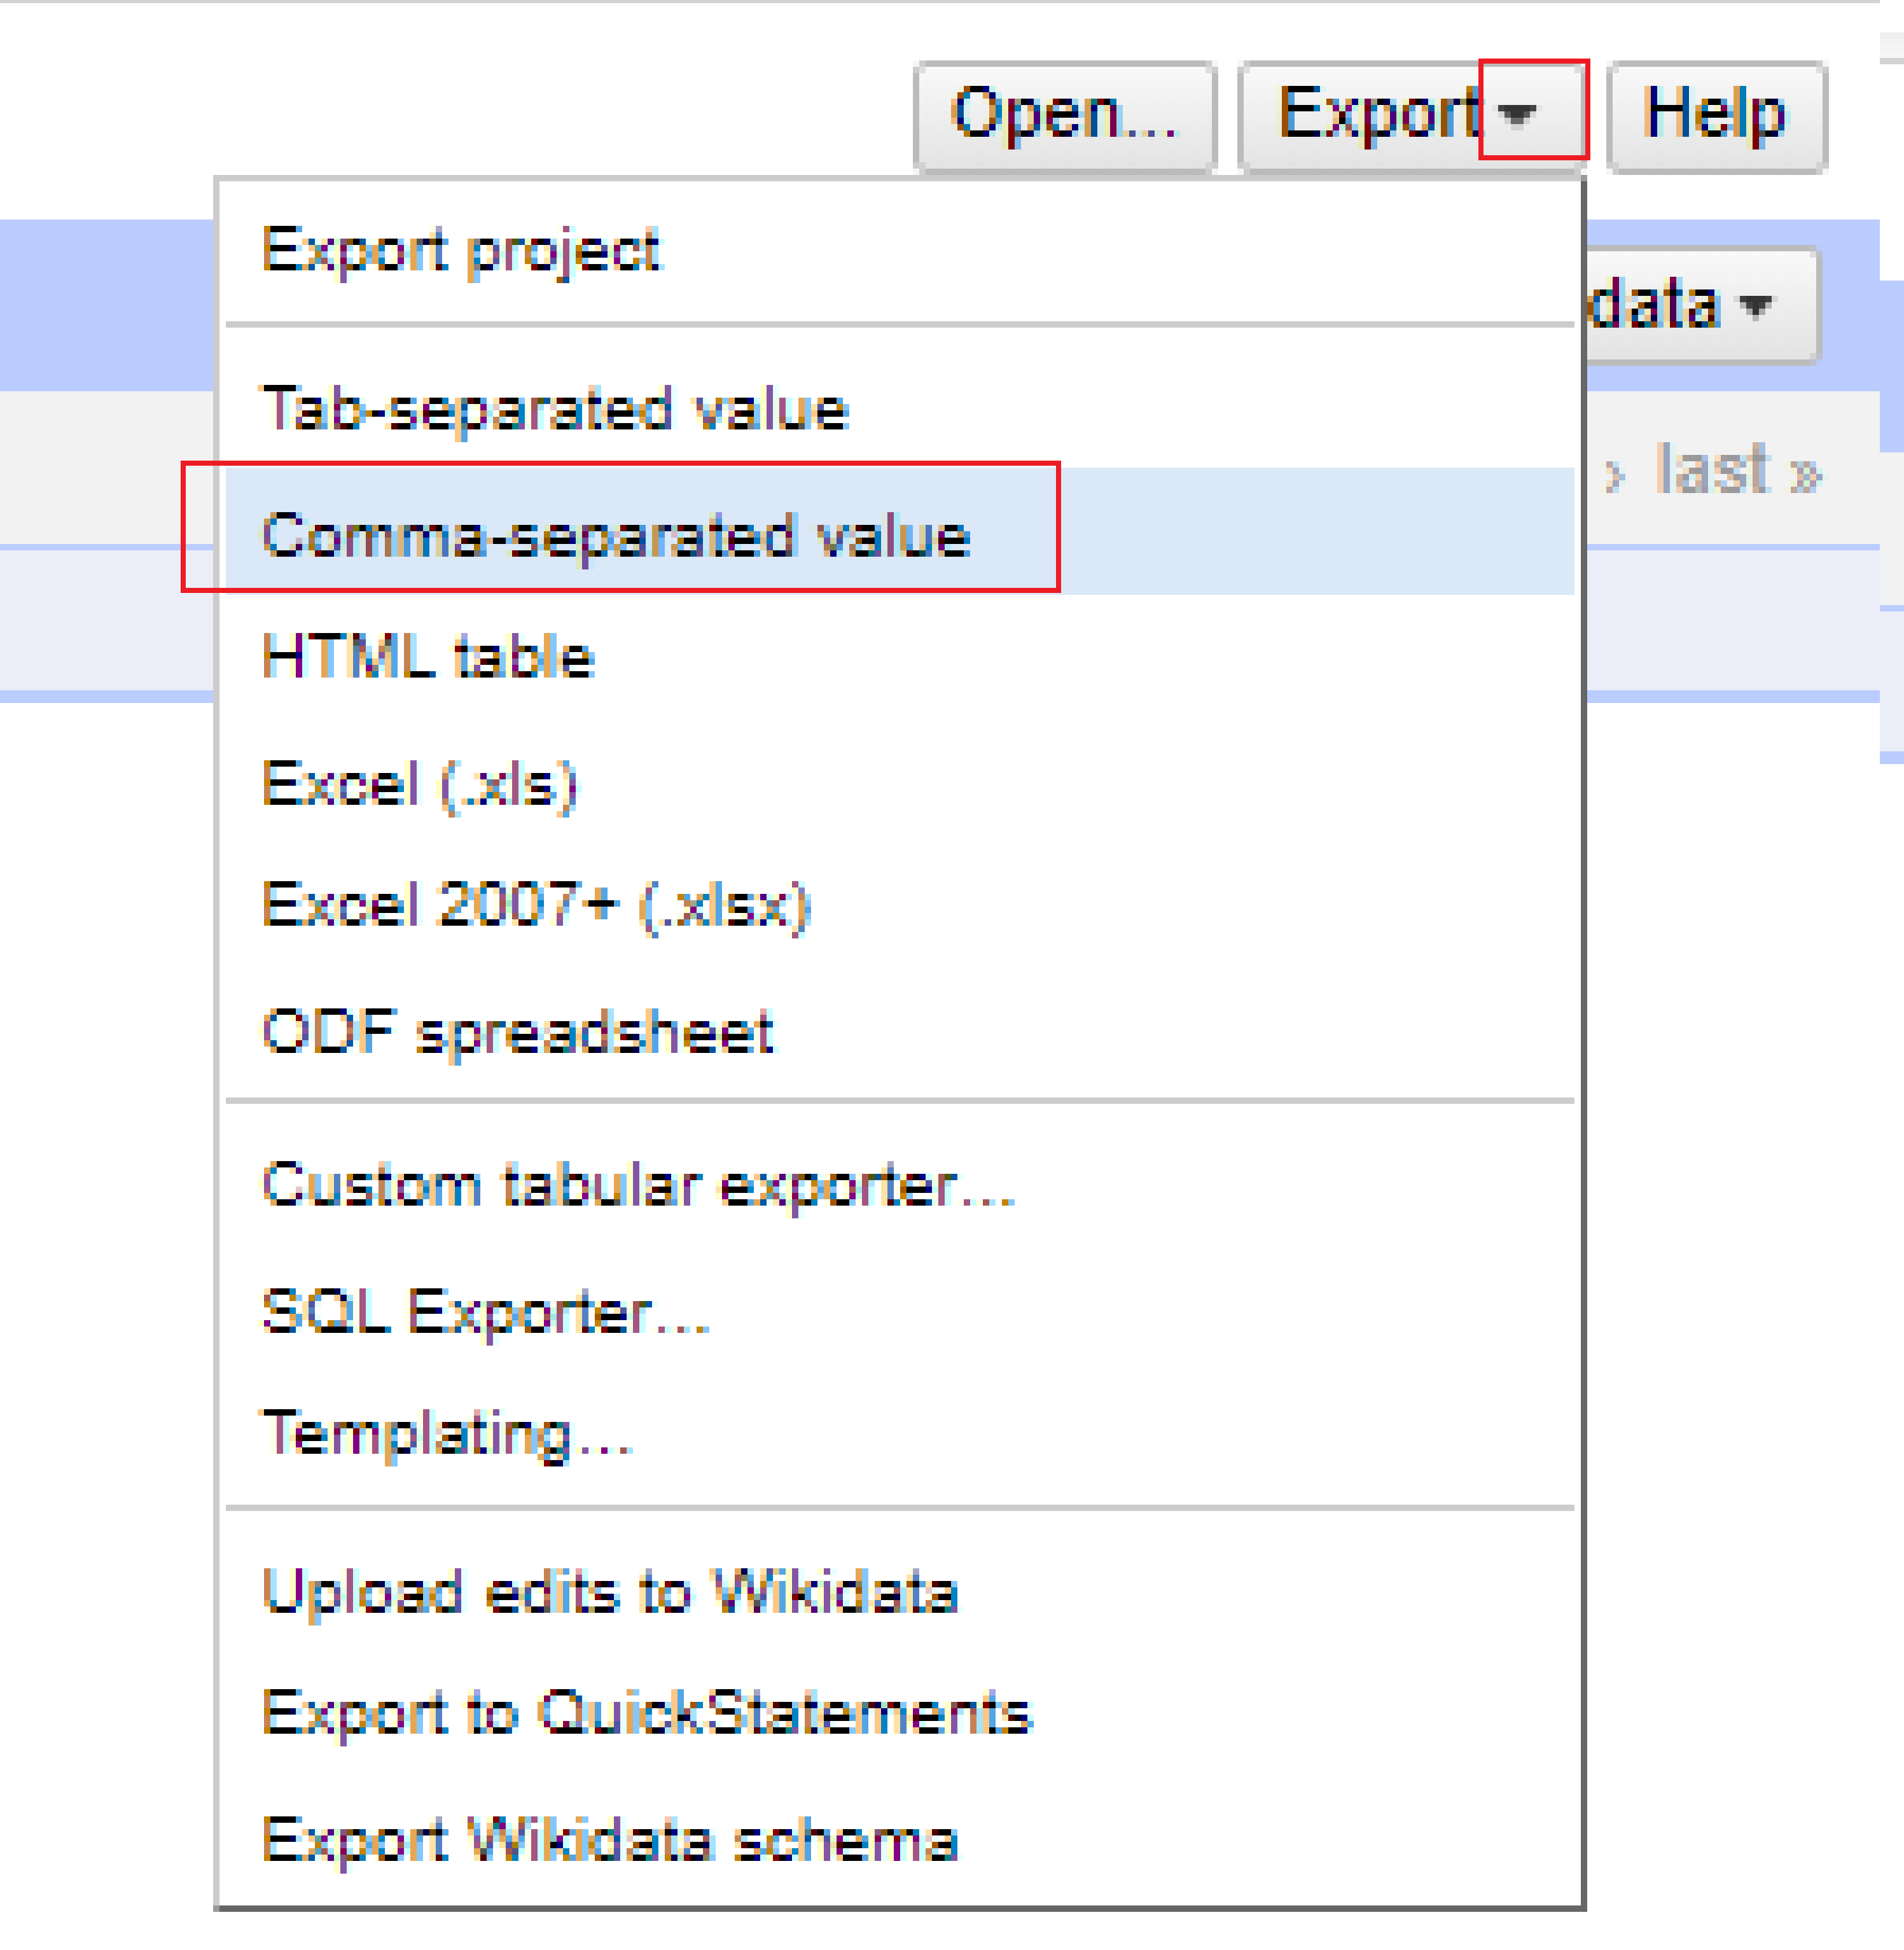
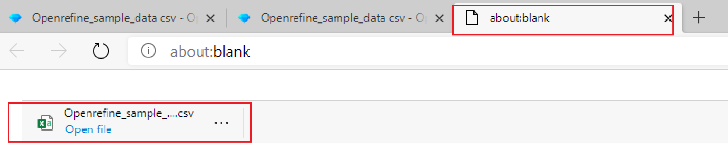
DATA CLEANING
How to export the data as CSV file?
1. Click on the LOV button near to Export button.
2. Click on the menu item, Comma-separated value
3. You can see a new .csv file created in a new window "about blank"

Slide 57


